Slide 1
Operator – Unit 2
By : Bhavika Vaghela
Asst. Prof.
PICA – BCA - PU

Slide 2
Python operator is a symbol that performs an operation on one or more operands.
An operand is a variable or a value on which we perform the operation.
Operators are the constructs which can manipulate the value of operands.
Consider the expression 4 + 5 = 9. Here, 4 and 5 are called operands and + is called operator.
Operators are special symbols in Python that carry out arithmetic or logical computation.
The value that the operator operates on is called the operand.
Operators are the pillars of a program on which the logic is built in a particular programming language.

Slide 3
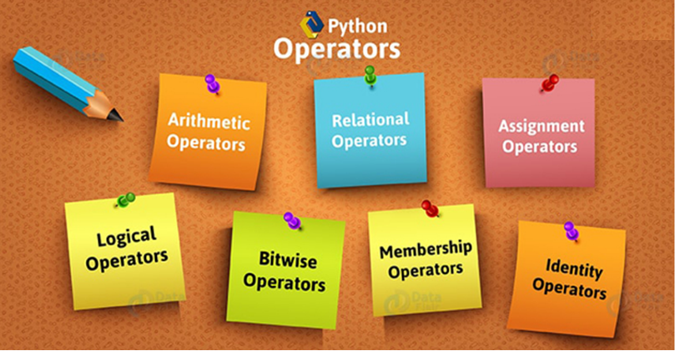
It falls under the 7 categories

Slide 4
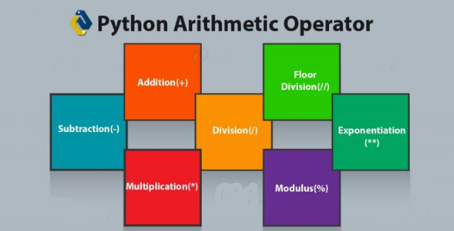
Arithmetic operators
Arithmetic operators are used to perform mathematical operations between two or more operands.
Addition (+) : use to add two or more operands. Value can be any integer or float.
if value is string or character than it perform concatenate operation.

Slide 5
Subtraction(-) : It is used to subtract the second operand from the first operand.
Subtracts the value on the right from the one on the left.
Division( / ) : It returns the quotient after dividing the first operand by the second operand.
Notice that division results in a floating-point value.
Multiplication(*) : It is used to multiply one operand with the other.
Exponentiation(**): calculates the first operand power to second operand.
Modulo ( % ) : Divides and returns the value of the remainder.
Floor Division(//) : Divides and returns the integer value of the quotient.

Slide 6
Example of Arithmetic Operator
>>> number1=10 >>> number2=2 >>> number1 + number2 (addition) 12 >>> number1-number2 (subtraction) 8 >>> number1*number2 (multiplication) 20 >>> number1/number2 (division) 5.0 >>> number1//number2 (floor division) 5 >>> number1%number2 (modulo) 0 >>> number2**6 (exponent) 64

Slide 7
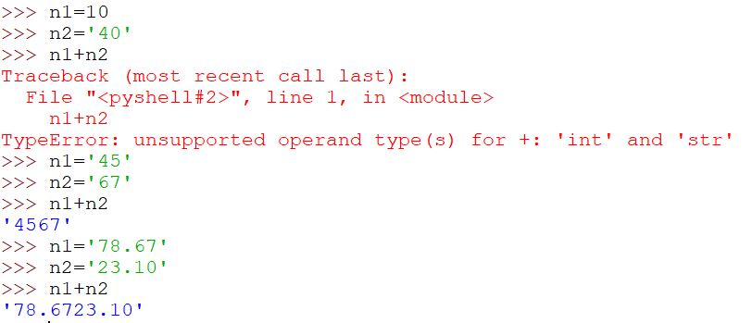
Example of Concatenations if operand or value is in string form

Slide 8
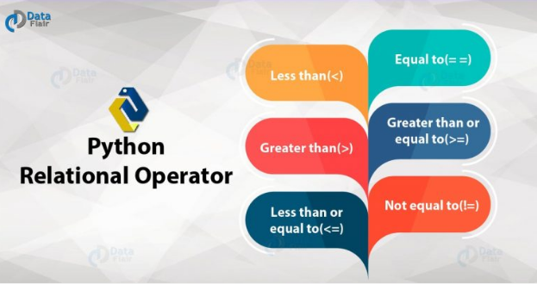
Relational Operator (Conditional Operator)
Relational Operator carries out the comparison between operands.
They tell us whether an operand is greater than the other, lesser, equal, or a combination of those and returns Boolean value.

Slide 9
Less than(<) : checks if the value on the left of the operator is lesser than the one on the right.
Greater than(>) : It checks if the value on the left of the operator is greater than the one on the right.
Less than or equal to(<=) : It checks if the value on the left of the operator is lesser than or equal to the one on the right.
Greater than or equal to(>=) : It checks if the value on the left of the operator is greater than or equal to the one on the right.
Equal to(= =) : This operator checks if the value on the left of the operator is equal to the one on the right.
Not equal to(!=): It checks if the value on the left of the operator is not equal to the one on the right.

Slide 10
Example of relational operator/ conditional operator
number1=10 number2=2 >>> number1>number2 (Greater than) True >>> number1<number2 (less than) False >>> number1!=number2 (not equal to) True >>> number1<=number2 (less than equal to) False >>> number1>=number2 (greater than equal to) True >>> number1==number2 (equal to) False

Slide 11
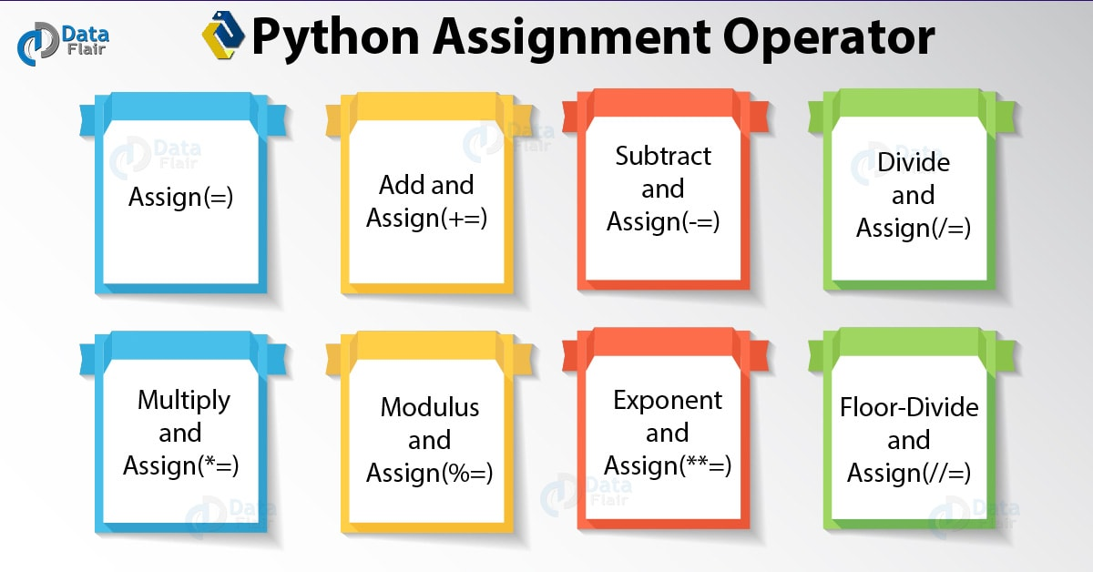
Assignment Operator (Short hand operator)
An assignment operator assigns a value to a variable. It may manipulate the value by a factor before assigning it.

Slide 12
Assign(=) : Assigns a value to the expression on the left.
Add and Assign(+=) : Adds the values on either side and assigns it to the expression on the left.
Subtract and Assign(-=) : Subtracts the value on the right from the value on the left. Then it assigns it to the expression on the left.
Divide and Assign(/=) : Divides the value on the left by the one on the right. Then it assigns it to the expression on the left.
Multiply and Assign(*=) : Multiplies the values on either sides. Then it assigns it to the expression on the left.
Modulus and Assign(%=) Performs modulus on the values on either side. Then it assigns it to the expression on the left.
Exponent and Assign(**=) : Performs exponentiation on the values on either side. Then assigns it to the expression on the left.

Slide 13
Floor-Divide and Assign(//=) Performs floor-division on the values on either side. Then assigns it to the expression on the left.
Example
>>> number1=10 >>> number1+=1 >>> print(number1) 11 >>> number1-=2 >>> print(number1) 9 >>> number1/=3 >>> print(number1) 3.0 >>> number1*=3 >>> print(number1) 9.0 >>> number1//=3 >>> print(number1) 3.0 | >>> number2=9 >>> number2//=3 >>> print(number2) 3 >>> number2=10 >>> number2%=3 >>> print(number2) 1 >>> number3=4 >>> number3**=3 >>> print(number3) 64

Slide 14
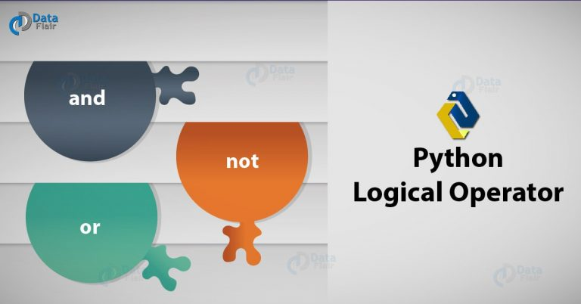
Logical Operator
The logical operators are used primarily in the expression evaluation to make a decision.
These are conjunctions that you can use to combine more than one condition. We have three Python logical operator – and, or, and not.
Returns Boolean value.

Slide 15
and : If the conditions on both the sides of the operator are true, then the expression as a whole is true.
or : The expression is false only if both the statements around the operator are false. Otherwise, it is true.
not : This inverts the Boolean value of an expression. It converts True to False, and False to True.
Example :
>>> number1=10 >>> number2=2 >>> number1 and number2 2 >>> number1>5 and number2<3 True >>> number1>11 or number2<3 True >>> not(number1>11) True
IT WILL CHECK CONDITION BOTH THE SIDE AND THAN GIVES OUTPUT
BASED ON ITS VALUE

Slide 16
Membership Python Operator
membership operators are used to test whether a value or variable is found in a sequence (string, list, tuple, set and dictionary).
We have two membership operator in and not in. It will return Boolean value.
in
not in
>>> tuple1=(1,2,"xyz",10.2,50) >>> 4 in tuple1 False >>> 4 not in tuple1 True >>> "xyz" in tuple1 True >>> "xyz" not in tuple1 False
Like tuple you can use membership
Operator on any data types like
String, list, set, dictionary, string

Slide 17
Identity Operator
These operators test if the two operands share an identity (Memory). We have two identity operators- ‘is’ and ‘is not’.
They are used to check if two values (or variables) are located on the same part of the memory. It returns Boolean value.
Example
is
Is not
>>> str1="apple" >>> str2="apple" >>> str1 is str2 True >>> str1 is not str2 False | >>> l1=[1,2,3] >>> l2=[1,2,3] >>> l1 is l2 False >>> l1 is not l2 True | >>> l3=[10,20,30] >>> l4=l3 >>> l3 is l4 True >>> l3 is not l4 False

Slide 18
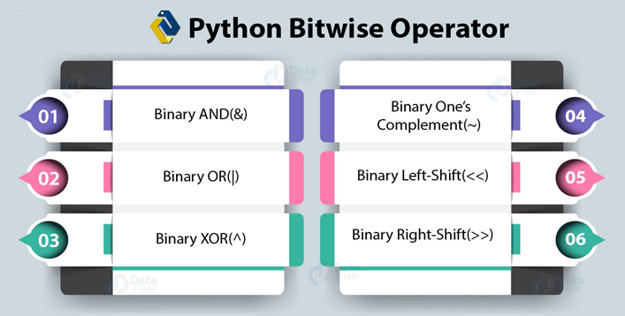
Bitwise Operator
The bitwise operators perform bit by bit operation on the values of the two operands.
If data is not in binary than it convert it first in binary and than perform operation.
It returns decimal as a result.

Slide 19
Binary AND(&) : it perform bit by bit and operation and if both bit at same place are 1 than put 1 else it will put 0.
Binary OR(|) : it perform bit by bit or operation and if both bit at same place is 0 than put 0 else it will put 1.
Binary XOR(^) : it perform bit by bit XOR ( exclusive or) operation. It will put 0 if both bit at the same place is same else put 1.
One’s Complement(~) / binary negative : It flips the bits. It will return 1 if bit is 0 and return 0 if bit is 1.
Left shift (<<) : The left operand value is moved left by the number of bits present in the right operand. E.g. 10<<n (n is number of bits and 10 is value)
Right shift (>>) : The left operand value is moved right by the number of bits present in the right operand. E.g 10>> n (n is number of bits and 10 is value)

Slide 20
Truth Table of Bitwise &, |, ^ or ~ operator
A | B | & (and) | | (or) | ^ (XOR)
0 | 0 | 0 | 0 | 0
0 | 1 | 0 | 1 | 1
1 | 0 | 0 | 1 | 1
1 | 1 | 1 | 1 | 0
A | ~ (not)
0 | 1
1 | 0

Slide 21
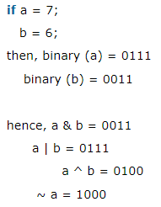
Example
>>> a=10 >>> bin(a) '0b1010' >>> a<<2 (left shift) 40 >>> bin(a<<2) '0b101000' >>> a>>2 (right shift) 2 >>> bin(a>>2) '0b10‘ >>> a<<3 (left shift with 3 bit) 80 >>> bin(a<<3) (left shift with 3 bit) '0b1010000‘ ## here 0b indicate binary value

Slide 22
Conditional Execution
In order to write useful programs, we almost always need the ability to check conditions and change the behavior of the program accordingly.
Conditional statements “if” give us this ability.
The Boolean expression after the if statement is called the condition.
If it is true than inside block is executed else not.
if x > 0:
print 'x is positive‘
List1=[1,2,3,4,5]
if len(List1)<6:
for i in List1:
print(i)
We can declare multiple if statements also within single program

Slide 23
if statements have the same structure as function definitions: a header followed by an indented block.
Statements like this are called compound statements.
There is no limit on the number of statements that can appear in the body.
Alternative execution
A second form of the if statement is alternative execution, in which there are two possibilities and the condition determines which one gets executed.
The alternatives are called branches, because they are branches in the flow of execution.
if x%2 == 0:
print 'x is even'
else:
print 'x is odd'

Slide 24
Chained conditionals
Sometimes there are more than two possibilities and we need more than two branches.
One way to express a computation like that is a chained conditional.
elif is an abbreviation of “else if.” Again, exactly one branch will be executed. There is no limit on the number of elif statements.
If there is an else clause, it has to be at the end. But it not mandatory to declare.
Each condition is checked in order. If the first is false, the next is checked, and so on. If one of them
is true, the corresponding branch executes, and the statement ends. Even if more than one condition
is true, only the first true branch executes.

Slide 25
Example of chained conditionals
number=int(input("enter any number :")) if number<10: print("number is lessthen 10") elif number>10 and number<15: print("number between 10 to 15") elif number>15 and number<20: print("number between 15 to 20") elif number>20 and number<25: print("number between 20 t0 25") ##else block is not mandatory

Slide 26
Nested conditionals
Bind condition within one condition is known as nested condition.
nested conditionals become difficult to read very quickly. In general, it is a good idea to avoid them when you can.
if x == y: print 'x and y are equal' else: if x < y: print 'x is less than y' else: print 'x is greater than y'
if 0 < x: if x < 10: print 'x is a positive single-digit number.'

Slide 27
Recursion
It is legal for one function to call another; it is also legal for a function to call itself.
In below example If n is 0 or negative, it outputs the word, “Blastoff!” Otherwise, it outputs n and then calls a function named countdown—itself—passing n-1 as an argument.
Infinite recursion
If a recursion never reaches a base case, it goes on making recursive calls forever, and the program
never terminates. This is known as infinite recursion, and it is generally not a good idea.
def countdown(n): if n <= 0: print 'Blastoff!' else: print n countdown(n-1)

Slide 29
Perform below listed programs
Write a menu driven program which shows use of all arithmetic operator.
Write a program which shows the difference between identity and membership operator.
Write a program to find maximum and minimum number from five numbers.
Write a program which shows the use of bitwise operator.
Write a program to sort element of list using conditional operator (don’t use sort() method).
Write a program which shows use of shot hand operator ( assignment operator)

Slide 30
https://www.programiz.com/python-programming/operators
https://data-flair.training/blogs/python-operator/
https://www.javatpoint.com/python-operators
https://www.w3schools.com/python/python_operators.asp
https://docs.python.org/3.4/library/operator.html
https://www.guru99.com/python-operators-complete-tutorial.html

